Slide 1


Evidence Based Decision Making in MA Public Education
DESE-DHE Collaboration on SLDS
October 2020 BHE update

Slide 2
Evidence Based Policymaking Effort (BHE/DHE Progress to Date)
Jan 2020. Established an evidence-based policymaking committee on each education board to build a tighter connection between department staff and board members on data-driven policy making
Jointly approved a shared vision for evidence-based policy making across DHE and DESE, which includes commitments to:
  Using available data to strategically drive policy decisions
  Responsive data sharing with key stakeholders, including researchers
  Producing and sharing actionable findings with end-users, including schools, institutions, and the communities that we serve

Slide 3
Recent Progress
Orientation meeting for BHE working group members
  Jonathan Keller and team brief BHE Chair Chris Gabrieli and BHE Members Alex Cortez and Ann Christensen (September 14th).
SLDS Review - Core DHE and DESE staff meeting
  Jonathan Keller, Matt Deninger (DESE), Chris Gabrieli, and Marty West (BESE)
  Examined a SWOB (Strengths, Weaknesses, Opportunities and Barriers) analysis of our SLDS (September 22nd).

Slide 4
Work in Progress
Review current and desired approaches to strengthening the capture, matching, and use of linked SLDS data
Examine data reports and dashboards for use by and relevance to policy makers and practitioners.
Identify SLDS-related operational issues and create an approach to address issues institutionally.
Generate actionable items for joint DHE/DESE board meeting in Dec/Jan.

Slide 5



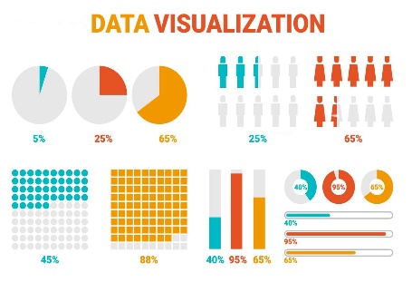
Keys to Success
Update on Evidence-Based Policymaking
To be successful, evidence-based policymaking must be attentive to:
Ensuring Data
Quality
Merging & Enriching Data
Facilitating Research Partnerships
Creating & Using Analytic
Tools

Slide 6
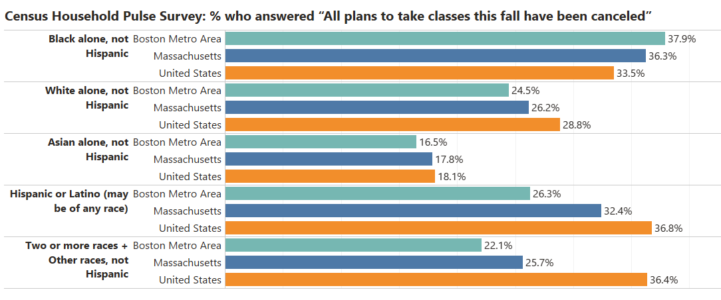
Addressing the Impact of
COVID-19 is an Equity Issue
Update on Evidence-Based Policymaking
Source: DHE tabulations of US Census Bureau, Household Pulse Survey Week 14 (September 2–14, 2020), Table 6: Impact of Coronavirus Pandemic on Post-Secondary Educational Plans, by Select Characteristics.
Population Surveyed: Total population 18 years and older in households where at least one adult was planning on taking classes this fall from a post high school institution. More info on sampling >

Slide 7

MA Postsecondary Degree Attainment Pipeline
Attain HS Degree
Attain Degree
FAFSA
Apply
Accept
Enroll
Attend
Persist
What are the pathways that Black, Latinx, Indigenous, low-income, and/or first gen students take in traversing from MA public K12 schools to college?
How can we rapidly identify the specific impacts of the pandemic on these populations so that we can design countermeasures to better serve the Class of 2021 and perhaps reach back to some members of the Class of 2020 as well?

Slide 8
SLDS Preliminary Findings: Pipeline Loss
7,955 economically disadvantaged (low-income) Black, Latino, or Indigenous high school graduates in the state in 2019.
Fifty high schools with the largest number of low-income Black, Latino, or Indigenous graduates each graduated at least 48 students.
  These schools accounted for 62% (4,922) of all low-income graduates of color.
Substantial concentration of students in several institutions of higher education.

Slide 9
SLDS Preliminary Findings: Pipeline Loss
For example, Brockton High School graduated 307 low-income students of color in 2019.
  52% enrolled in college in the fall, mostly (83%) in MA public institutions.
  Of the students who enrolled in MA public institutions, 79% enrolled in 3 schools:
    81: Massasoit Community College (73 students),
    22: Bridgewater State University (19 students),
    23: UMass – Amherst (10 students).

Slide 10
Stability in Student Enrollment in the Top-4 Enrollment Colleges

Slide 11
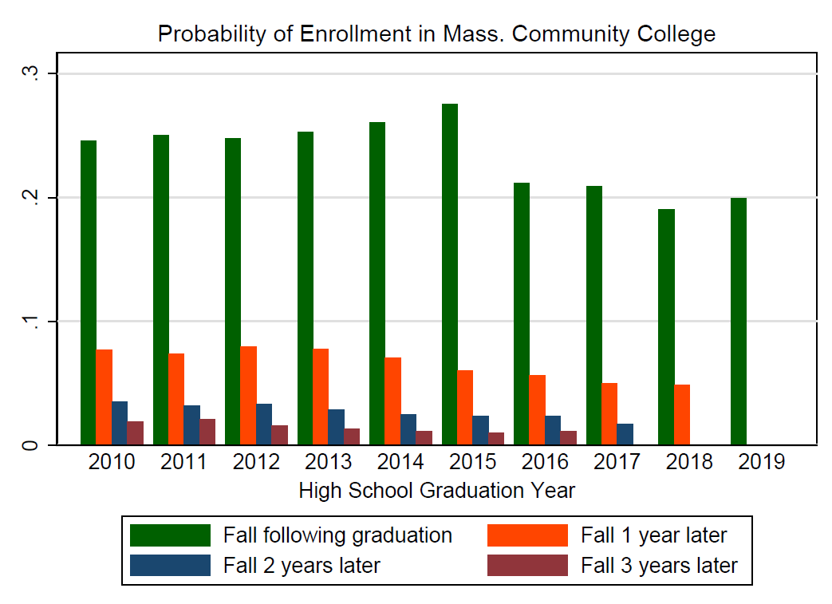
Probability of Enrollment in MA Community College

Slide 12
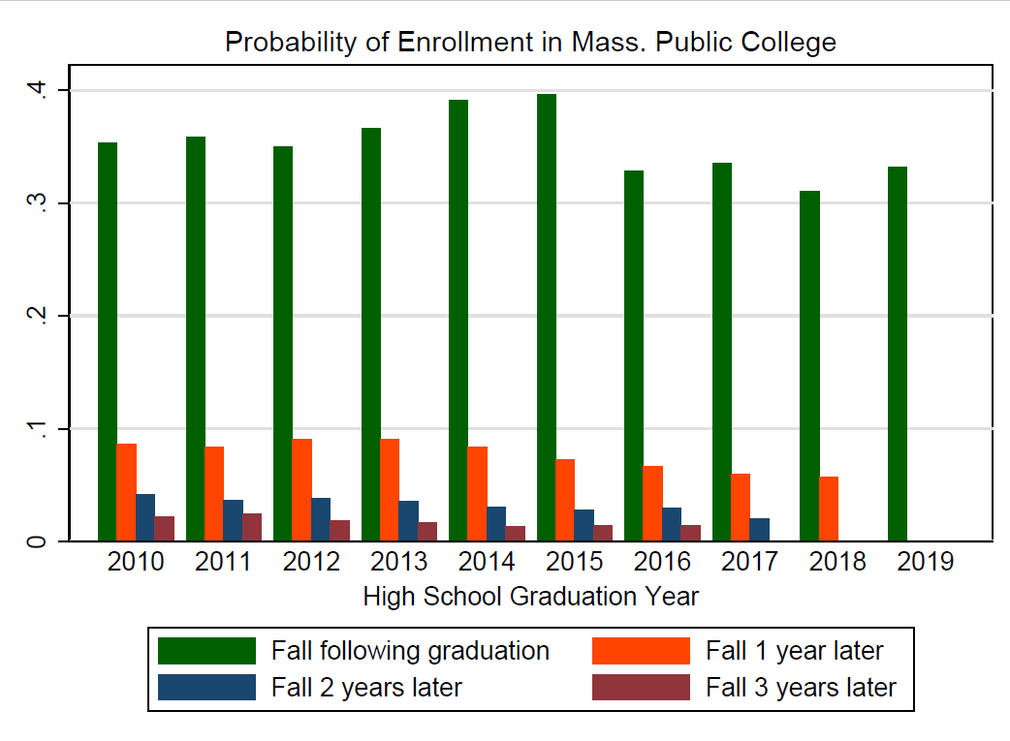
Probability of Enrollment in MA Public College

Slide 13
Next Steps
Initial Report – Long-term pipeline and class of 2020/2021
  Collaboration between DESE and DHE
  Describe multi-year patterns in MA college pipeline
  Rapid response to target graduating class of 2021
Action
  We intend to hold a special meeting of the joint Boards to discuss progress and opportunities, both for SLDS overall and for the Class of 2021 challenge, in approximately January 2021
  Create systems of support to strengthen this pipeline

